Slide 1

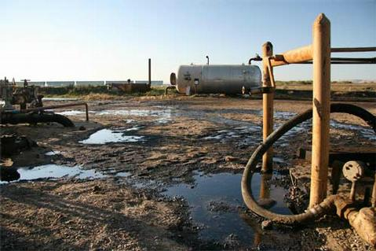
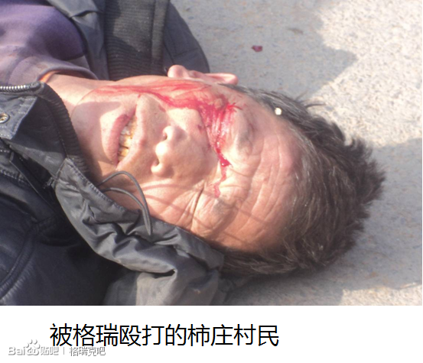

Founder, Chairman, Chief Executive And Sole Executive Director
Green Dragon Gas Ltd
RANDEEP GREWAL
Toxic in the US
Violent in China
Listed on AIM
Toxic in the US since 1999
400 Spills since 1999
452,000 Gallons of toxic fuel into local creeks and soils
1,700 Violations of county regulations
Violent and Illegal in China
Illegal operations to develop and sell CBM
Illegal occupancy of Land
Organize gangsters to assault villagers
Default payments to contractors
Tax evasion
Raised US$500M on AIM
With no disclosure since 2006

Slide 2
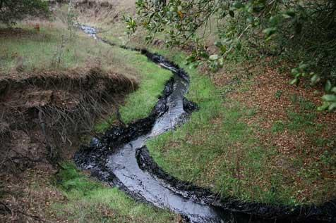
400 Spills since 1999
452,000 Gallons of toxic fuel into local creeks and soils
1,700 Violations of county regulations
U.S.
Randeep Grewal held directorships in the following companies: Greka Integrated Inc., Santa Maria Refinery (formerly Greka Energy Corporation), HVI Cat Canyon Inc. (formerly Greka Oil & Gas Inc). Since 1999, the company has been buying old oil and gas leases-and their aging facilities-from industry giants like Shell and Unocal. Greka owns 77 facilities, 11 stations, and several hundred wells in Santa Barbara County, though many of the latter currently are not in use.
A Greka spill (from the "Union Sugar Lease Tank Battery") in 2008.
S.B. County Fire Department Taking a substantial toll on plant and wildlife, not to mention water-table supplies, leaked oil makes its way down a seasonal creek on Greka’s Zaca lease

Slide 3
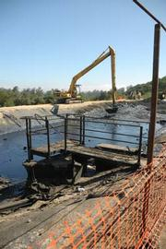
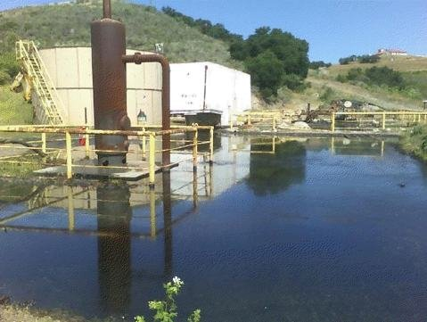
A Federal Environmental Protection Agency-run clean-up effort tackles an oil-choked Storage pool-caused by a busted pipe-just off Palmer Road, a few miles north of Los Alamos.

Slide 4
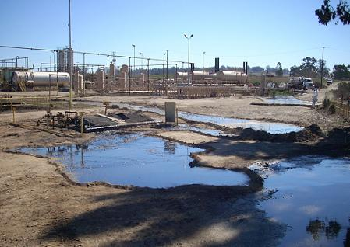
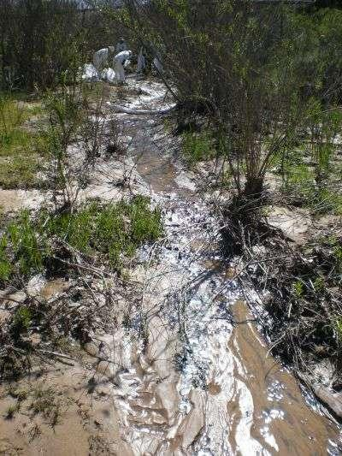
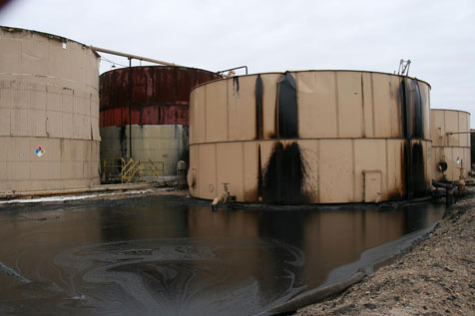
Greka spill March 3, 2008

Slide 5
Testimonies
“Of 21 refineries in California, Greka Oil & Gas Inc. is the fourth-smallest producer, but the state's biggest inland oil polluter”, according to state officials.
"I've been in the hazardous materials business for 20 years and this is the worst oil company I've ever seen," said Robert Wise, who works at EPA's Superfund division.
"Right now I can't think of anybody that is worse than Greka," said Steve Edinger, assistant chief of Fish and Game. "They are the biggest inland oil pollution problem we are dealing with across California. Nobody has our attention like Greka does."
"I believe in giving people and businesses more than one chance, a number of chances if they're trying to make things right, but I don't believe in 400 chances," said Doreen Farr, a former planning commissioner running for a seat on the board.

Slide 6
2006
In November 2006, Greka Energy Corp, headed by Randeep Grewal, reached a settlement in a civil lawsuit that had accused Greka Energy of more than 100 safety and environmental violations by its onshore oil and gas facilities in Santa Barbara County, California. The suit claimed Greka operated many of its onshore oil and gas facilities without permits and failed to repair and maintain deteriorating equipment likely to cause explosions, fires and the release of poisonous gas.
The suit also alleged that the company did not train or equip employees adequately, and failed to respond to an alert system designed to prevent an underground pipeline rupture. Under the settlement, Greka agreed to pay US$ 75,000 in civil penalties, with half going to Santa Barbara County, and the other half to the county Air Pollution Control District. The settlement stipulated that Greka will pay an additional US$ 150,000 in civil penalties to the county and the Air Pollution Control District if it makes another similar violation during the next three years. The total amount in civil penalties paid by Greka to the county and Air Pollution Control District as a result of settlements in the case was US$ 675,000.

Slide 7
2007
In June 2007, the Santa Maria Refining Company, a subsidiary of Greka Energy Corporation, pleaded guilty to criminal charges of violating the Safe Drinking Water Act in Santa Maria, California.
Since April 2004, the US Environmental Protection Agency (EPA) had been investigating allegations that officials at Greka had "knowingly and routinely" discharged oil refinery waste into underground injection wells that are permitted only for the disposal of brine, which is separated from crude oil during the refining process. Investigators said the wastewater contained benzene, a chemical that can cause cancer, anemia, excessive bleeding as well as damage to the immune system.
In court documents, the company admitted to intentionally pumping contaminated wastewater into the injection wells. The company also was sentenced for making false statements to the EPA. In addition to the penalty and probation, the company was asked pay the EPA $15,500 in restitution, and implement an independently audited environmental compliance program. Three individual defendants had also pleaded guilty to making false statements to the EPA in connection with this case. The company was also given a penalty of US$ 1,000,000.
In a separate action in June 2006, the EPA fined the refinery $127,500 for unauthorized disposal of oil refinery wastewater into the wells.

Slide 8
2011
In March 2011 Santa Barbara County announced details of an agreement reached with Greka after approximately two years of contentious negotiations. Greka agreed to pay $2 million between 2011 and 2014 as compensation for the series of spills which occurred in late 2007 and early 2008, events which included more than 1700 violations of County regulations. Additionally, Greka promised to improve their infrastructure to make future spills less likely, including reinforcing containment structures. Greka changed its name to HVI Cat Canyon, Inc. in May 2011, going back to a name it had used prior to 1999 for its operations on the East Cat Canyon Oil Field.
On June 17, 2011, the U.S. Department of Justice, California Department of Fish and Game, and California Regional Water Quality Control Board filed suit against Greka in Federal court in Los Angeles for having failed to comply with the requirements of the Clean Water Act, citing 21 oil and contaminated water spills between 2005 and 2010. The amount sought was in excess of $2.4 million.
Congressmember Lois Capps issued a statement on the matter. “I hope today’s action by the EPA and the State of California will ensure Greka is held accountable for the damage it did to our environment and local economy,” said Capps. “For far too long, Greka failed to take the steps any responsible company would take to ensure it operated safely, attempting to shift the blame onto others and leaving cleanup costs for Santa Barbara County taxpayers to pick up. That is simply unacceptable and I hope today’s action ensures we never see this kind of irresponsible behavior again.”

Slide 9
Illegal operations to develop and sell CBM
Illegal occupancy of Land
Organize gangsters to assault villagers
Default payments to contractors
Tax evasion
……
Violent and Illegal In China
Randeep Grewal held directorships in the following companies Green Dragon Gas or its subsidiaries Greka Gas China, Greka China Ltd, Greka Energy (Int’l) BV etc which have business of exploration and production of Coal Bed Methane gas and distribution and sale of wholesale gas in China.
Source From Chinese Media:
http://tieba.baidu.com/p/2503705792

Slide 10
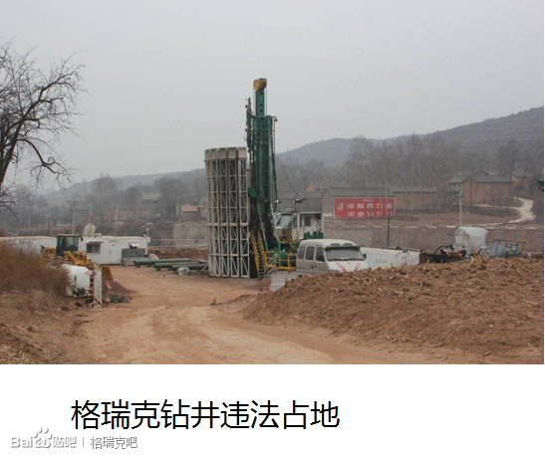
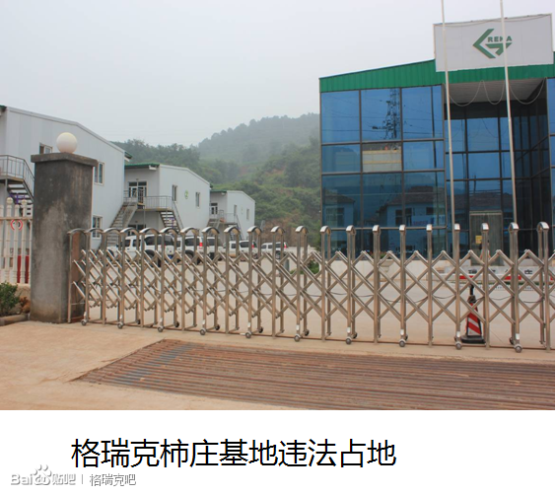
Illegal Occupancy of Land
Exploration and development activities of CBM in China need to obtain land use permit. Temporary land use permit is normally valid for 2 year and doesn’t allow construction of permanent buildings. Greka’s Zaoyuan gas compression station and operation base in Shuizhuang, Shanxi Province, as permanent buildings which should obtain permanent land use permit, still held expired temporary land use permit.
Illegal land use of Greka’s drilling pad
Illegal land use of Greka’s operation base in Shizhuang village

Slide 11
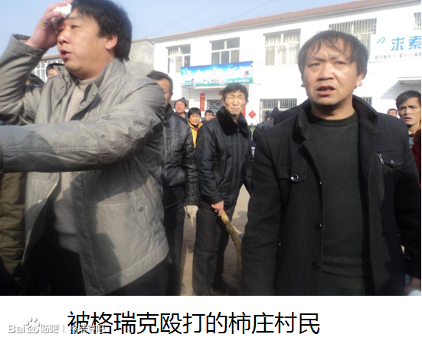
As reported on Baidu Tieba,
Greka defaulted on land compensation payments and organized gangsters to assault villagers
In Feb 2013, when villagers protested at Greka’s opration base in Shizhuang, more than 30 gangsters in black uniform came out with sticks to assault the villagers. It is said that those gangsters were hired in advance to drive out protestors. At least 4 were injured and criminal police investigated. Greka compensated all medical expenses of those injured villagers.
Injured villager
Injured villager

Slide 12
Other Accusations
Greka was actually developing its GSS Block without Overall Development Plan (ODP) approval from central government of China. 93 CBM wells, 1 gathering station and 1 West-East pipeline have been completed.
Greka was charged with tax evasion and fined by National Tax Bureau in Qinshui County in 2006 and 2008
By the end of 2012, Greka’s default payment to local engineering contractors amounted to RMB 200 million. In 2013, more than ten creditors went to Greka’s operation base in Shizhuang to ask for payment of debt but only received a handful.

Slide 13
Raised US$500M on AIM
Disclosure
Date | Fundraisings | $M | Debt Repaid $M
17-Aug-06 | AIM IPO Prospectus | 25
5-Jun-07 | issse of CBs | 50
30-Oct-07 | issse of CBs | 45
16-May-08 | placing | 37
5-Mar-09 | rights issue | 9.6
8-Dec-09 | placing | 75 | 55
8-Jun-10 | issse of CBs | 50
23-Sep-10 | issse of CBs | 50
3-Dec-10 | placing | 102.8
16-Feb-11 | Greka Drilling demerger and AIM listing Prospectus
7-Mar-11 | placing | 50
5-Jun-13 | secured bonds issue and asset disposal | 100 | 85
2005 Nov, bankruptcy of Saba Enterprises Inc (formerly Greka Energy Corporation);
environmental investigation of Greka Integrated Inc in 2006 and settlement of $0.7m
In June 2007, the Santa Maria Refining Company, a subsidiary of Greka Energy Corporation, pleaded guilty to criminal charges of violating the Safe Drinking Water Act in Santa Maria, California.
Non Disclosures
In March 2011 Greka settled with Santa Barbara County for $2 million as compensation for the series of spill including more than 1700 violations of County regulations.
On June 17, 2011, the U.S. Department of Justice, California Department of Fish and Game, and California Regional Water Quality Control Board filed suit against Greka in Federal court in Los Angeles.

